Slide 1
SQL Schema Creation and Queries
RISHI KIRAN

Slide 2
Creating Tables
CREATE TABLE department (
department_id INT PRIMARY KEY,
department_name VARCHAR(255) NOT NULL
);
CREATE TABLE year (
year_id INT PRIMARY KEY,
year_name VARCHAR(50) NOT NULL
);
CREATE TABLE students (
student_id INT PRIMARY KEY AUTO_INCREMENT,
student_name VARCHAR(255) NOT NULL,
department_id INT,
year_id INT,
FOREIGN KEY (department_id) REFERENCES department(department_id),
FOREIGN KEY (year_id) REFERENCES year(year_id)
);

Slide 3
Inserting Data
INSERT INTO department (department_id, department_name) VALUES
(66, 'CSE'), (67, 'ECE'), (68, 'ME'), (69, 'CE'), (70, 'EE');
INSERT INTO year (year_id, year_name) VALUES
(21, 'First Year'), (22, 'Second Year'), (23, 'Third Year'), (24, 'Fourth Year');
INSERT INTO students (student_name, department_id, year_id) VALUES
('Alice', 66, 21), ('Bob', 66, 21), ('Charlie', 66, 21), ('David', 66, 21), ('Eve', 66, 21),
('Frank', 67, 21), ('Grace', 67, 21), ('Heidi', 67, 21), ('Ivan', 67, 21), ('Judy', 67, 21),
('Mallory', 68, 21), ('Niaj', 68, 21), ('Olivia', 68, 21), ('Peggy', 68, 21), ('Sybil', 68, 21),
('Trent', 69, 21), ('Victor', 69, 21), ('Walter', 69, 21), ('Xander', 69, 21), ('Yvonne', 69, 21),
('Zara', 70, 21), ('Bill', 70, 21), ('Carl', 70, 21), ('Dylan', 70, 21), ('Ethan', 70, 21);

Slide 4
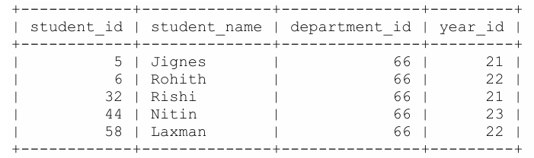
Query 1: Display Students from CSE Department
select * from students where students.department_id=(select department_id from department where department_name="CSE");

Slide 5
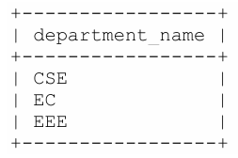
Query 2: Display Only Department Names
select distinct department_name from students join department on students.department_id = department.department_id;

Slide 6
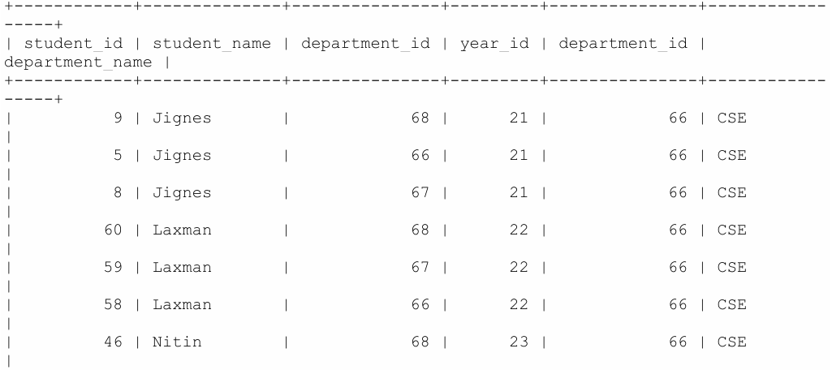
Query 3: Display Students Sorted by Department and First Name
select * from students,department order by department.department_name,students.student_nam;

Slide 7
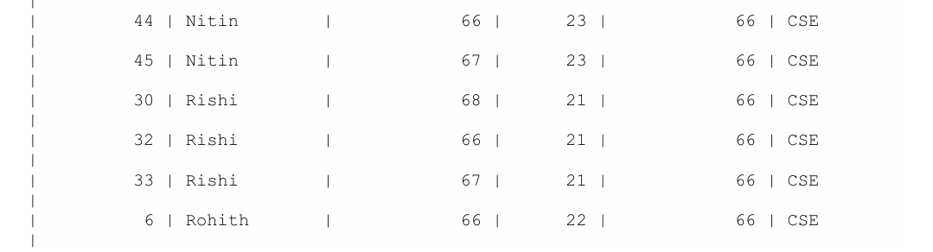
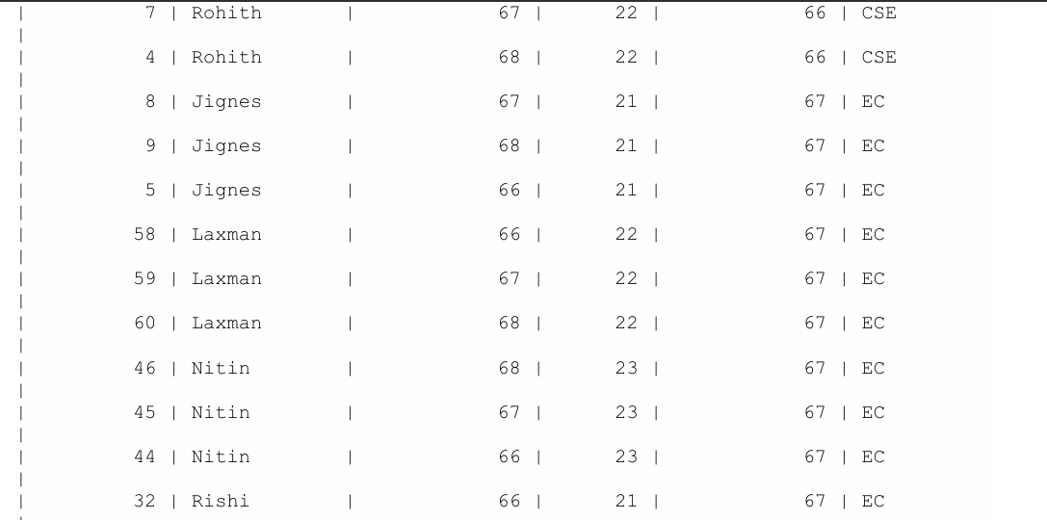

Slide 8
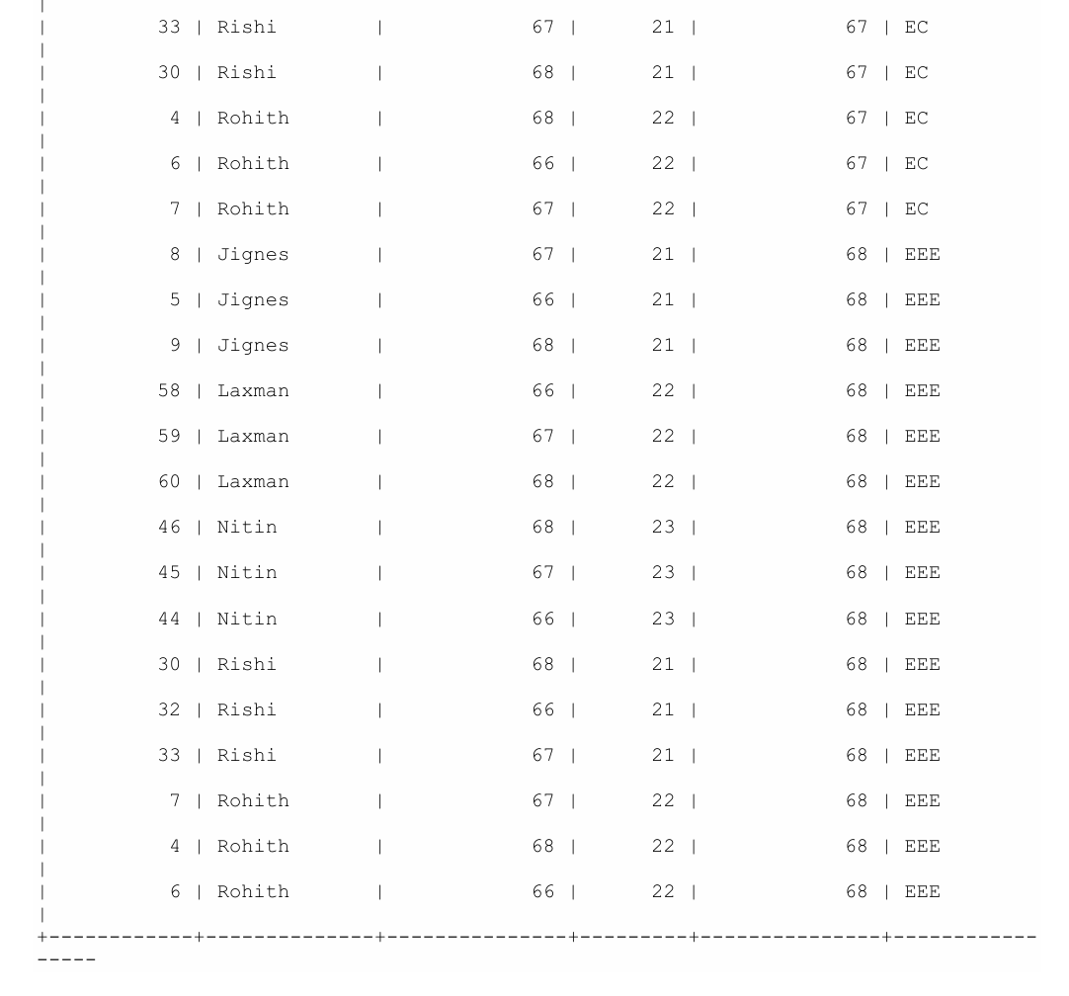

Slide 9
Introduction to MongoDB with MongoDB Atlas
MongoDB is a popular NoSQL database that provides high performance, high availability, and easy scalability. It uses a flexible document model, allowing you to store data in JSON-like documents with dynamic schemas.
MongoDB Atlas is the global cloud database service for MongoDB, providing fully managed databases on AWS, Azure, and Google Cloud. It offers features like automated backups, monitoring, and security features like encryption at rest and in transit.

Slide 10
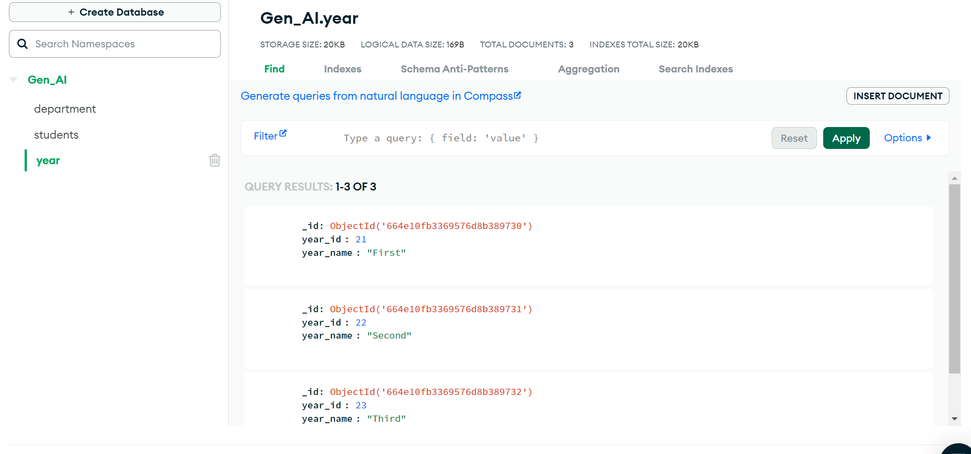

Slide 11
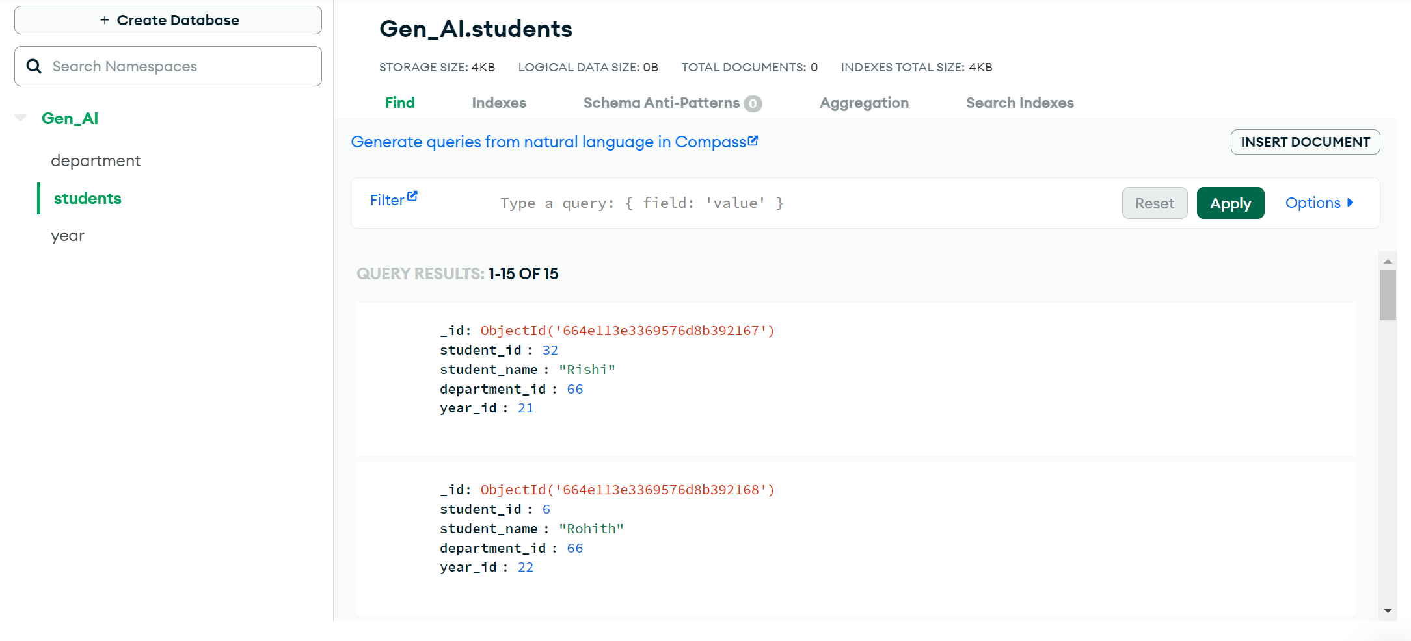

Slide 12
